Slide 1



Newborn Screening Interoperability Project
Kick-off Meeting
Enter Date

Slide 2

Welcome & Introductions
Tell us who you are and how newborn screening is a part of your work.

Slide 3

Goals for Today’s Kick-off
Meet project participants
Discuss “The Why”
Provide project goals/objectives
Introduce technical resources/partners
Describe data flow options and an overview of the implementation process
Define the hospital’s role of an early adopter
Discuss next steps
Then:
Tour facility to see current Newborn
Screening processes
Meet with IT staff

Slide 4



Why is this project important?
What is Newborn Screening?
Newborn Screening is a mandated, statewide program whose mission is to improve the quality of life and in some cases save the lives of babies diagnosed with one of the disorders tested
Symptoms may not be visible at birth, but these conditions can have serious consequences if not treated quickly
If diagnosed and treated quickly, the potentially catastrophic effects of the baby's condition can be avoided
Quality data and quick access to results are vitally important!

Slide 5
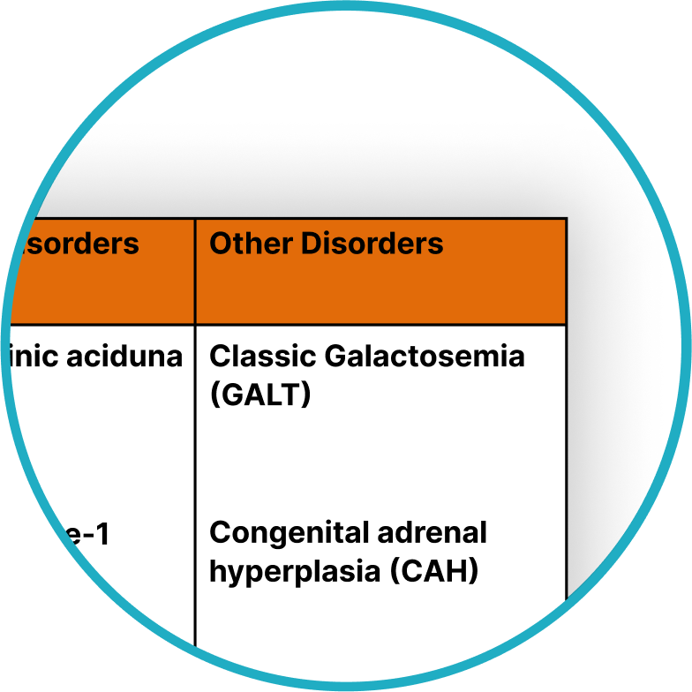

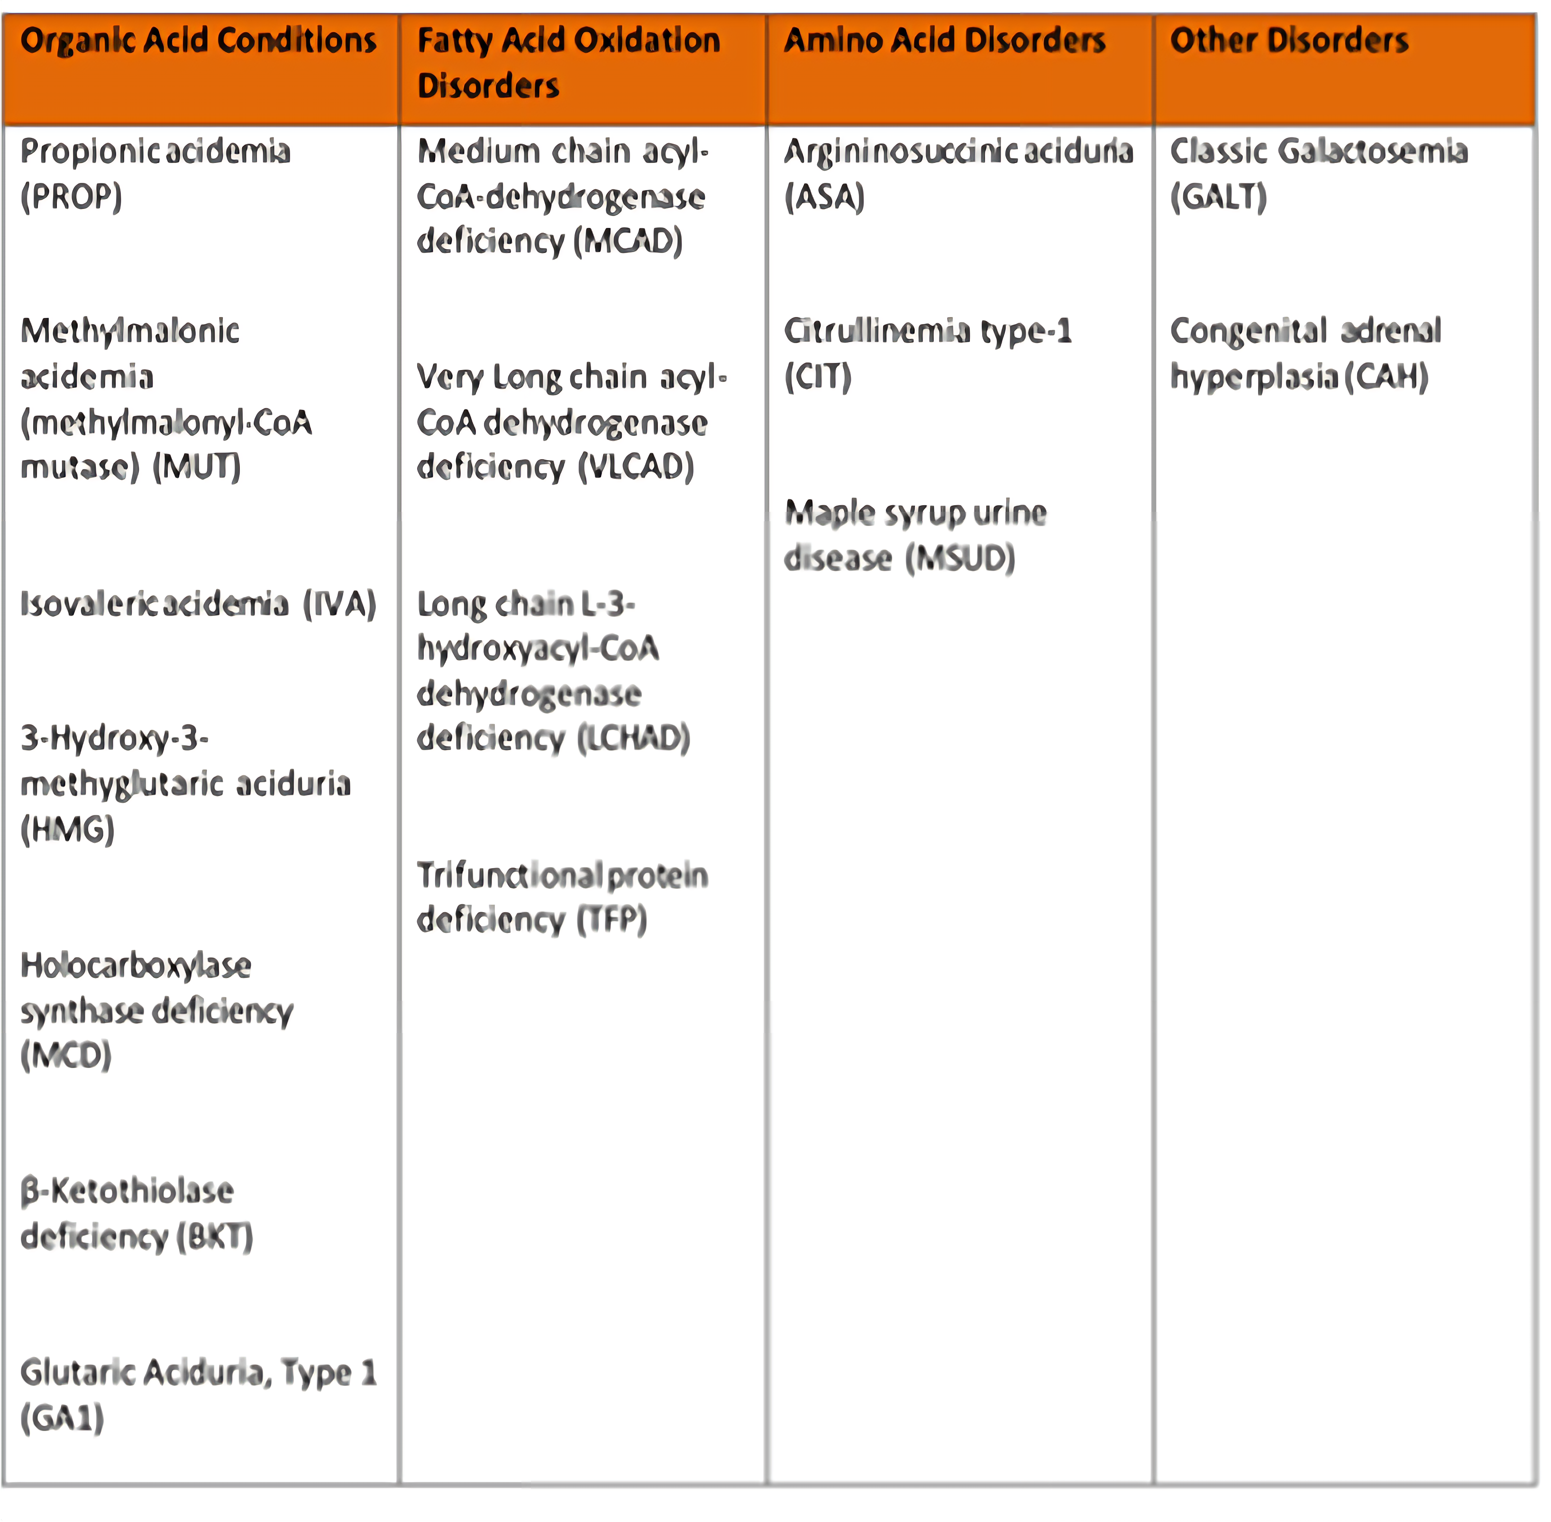
Many Newborn Screening Disorders are Categorized as “Time-critical” Conditions
Time-critical conditions - conditions that may manifest with acute symptoms in the first days of life and require immediate treatment to reduce risk of morbidity and mortality.
* as defined by ACHDNC
Galactosemia – for example:
Potential life-threatening symptoms of Galactosemia in Newborns
Swelling of the brain/increased intracranial pressure
Spitting up or vomiting; not wanting to eat
Kidney issues
Jaundice/liver failure
Sepsis
These symptoms can occur immediately after birth as a result of consuming too much galactose (either through breast milk or dairy-containing formula).
16 out of the 30+ disorders screened are identified as “time-critical”

Slide 6





Receiving complete and accurate submission data & delivering timely and accurate results are key
E-messaging plays a critical role in improving data quality and timeliness

Slide 7



Project Goals and Objectives
Improve patient safety
By improving data quality
By improving the timeliness of access to results
Gain efficiencies
By eliminating manual processes for both the hospital and the PHL
By reducing time spent on NBS-related tasks
Leverage existing partnerships /functionality to speed implementation
iConnect Lab Web Portal
SHARE

Slide 8





Enter Software App Partner Information
Established …
Vast experience….
Other customers/partners…
Programs supported…

Slide 9
Provide Data Flow Options
Scenario 1:
Hospital-only interface

Slide 10
Provide Data Flow Options
Scenario 2:
Hybrid interface

Slide 11
Provide Data Flow Options
Scenario 3:
Hospital uses web portal

Slide 12

Implementation Process
Technical considerations:
Establishing connectivity to facilitate HL7 orders and results exchange
Can a hospital provide complete HL7 lab order or ADT only or a hybrid?
Does hospital need online form to complete collection info?
Does hospital have ability to print labels to go on the collection cards?
Do units have access to label printers in the area where NBS samples are collected?
Can a hospital accommodate HL7 results coming back?
Any notification/follow-up tasks?
Key implementation milestones:
Requirements gathering
Development & configuration
Connectivity testing
End-to-end validation
User acceptance testing
Go-live readiness checklist
Hardware requirements
Label printers
Barcode Scanners

Slide 13




As an Early Adopter
Participate in the implementation process
Offer feedback and share ideas to enhance functionality and streamline processes
Gather “before vs after” data to demonstrate benefits/ROI, such as
Time spent on sample prep
Time spent researching missing data when called by the PHL and/or # of calls received from the PHL
Time between sample collection and results accessible in EMR
Additional benefits identified/efficiencies gained

Slide 14



Next Steps
PHL Team will digest information gathered today and begin drafting site requirements
PHL Team will work with you to:
Establish a communication plan
Establish project plan and timeline
Start gathering timeliness “before” data
Hospital Team will begin informing and educating staff:
Changing processes will not be easy for some – so share the plan, “The Why” and the anticipated benefits

Slide 15

Contact Information
Emily Hopkins, VA/DCLS Director of Laboratory Operations
emily.hopkins@dgs.virginia.gov

